Slide 1
A Software Testing Strategy
Unit testing begins at the vortex of the spiral and concentrates on each unit (i.e., component) of
the software as implemented in source code.
In integration testing, the focus is on design and the construction of the software architecture.
In validation testing, requirements established as part of software requirements analysis are validated against the software that has been constructed.

Slide 2
A STRATEGIC APPROACH TO SOFTWARE TESTING
A strategy for software testing must accommodate
low-level tests that are necessary to verify that a
small source code segment has been correctly
implemented as well as high-level tests that validate
major system functions against customer requirements.
• Testing and debugging are different activities, but
debugging must be accommodated in any testing
strategy.
A strategy provides guidance for the practitioner and
a set of milestones for the manager.

Slide 3
i. Verification and Validation
Verification: "Are we building the product right?"
Validation: "Are we building the right product?"

Slide 4
ii. Organizing for Software Testing
Testing : an attempt to “break” software
Builder’s point of view: testing is destructive.
builder treads lightly, designing and executing
tests that will demonstrate that the program works,
rather than uncovering errors.
If the software engineer doesn't find errors,
the customer will!

Slide 5
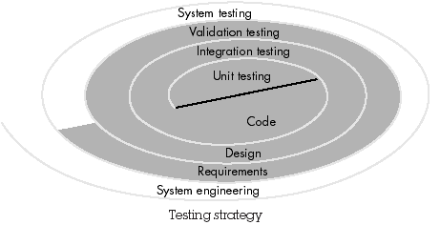
iii. A Software Testing Strategy
.
At system testing, the software and other system elements are tested as a whole.

Slide 6
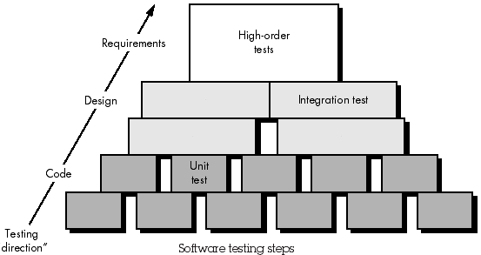
iii. A Software Testing Strategy
Testing is actually a series of four steps that are implemented sequentially.

Slide 7
iii. A Software Testing Strategy
Unit testing makes heavy use of white-box testing techniques, exercising specific paths in a module's control structure to ensure complete coverage and maximum error detection.
Next, components must be assembled or integrated to form the complete software package. Integration testing addresses the issues associated with the dual problems of verification and program construction.
Black-box test case design techniques are the most prevalent during integration
Software, once validated, must be combined with other system elements (e.g., hardware, people, databases).

Slide 8
Validation criteria
Functional requirements
Behavioral requirements
performance requirements.

Slide 9
iv. Criteria for Completion of Testing
"When are we done testing—how do we know that we've tested enough?"
"You're never done testing, the burden simply shifts from you to your customer."

Slide 10
iv. Criteria for Completion of Testing
Every time the customer/ user executes a computer program, the program is being tested.
"When are we done testing?"
"You're done testing when you run out of time or you run out of money."

Slide 11
STRATEGIC ISSUES
Specify product requirements in a quantifiable manner long before testing commences.
State testing objectives explicitly.
Understand the users of the software and develop a profile for each user category.
Develop a testing plan that emphasizes “rapid cycle testing.”

Slide 12
STRATEGIC ISSUES
Build “robust” software that is designed to test itself. (anti-bugging)
Use effective formal technical reviews as a filter prior to testing.
Conduct formal technical reviews to assess the test strategy and test cases themselves.
Develop a continuous improvement approach for the testing process.

Slide 13
i. UNIT TESTING
Focuses verification effort on the smallest unit of software design—the software component or module.
Using the component-level design description as a guide, important control paths are tested to uncover errors within the boundary of the module.
The unit test is white-box oriented, and the step can be conducted in parallel for multiple components.

Slide 14
i. Unit Test Considerations
The module interface is tested to ensure that information properly flows into and out of the program unit under test.
The local data structure is examined to ensure that data stored temporarily maintains its integrity during all steps in an algorithm's execution.

Slide 15
i. Unit Test Considerations
Boundary conditions are tested to ensure that the module operates properly at boundaries established to limit or restrict processing.
independent paths (basis paths) through the control structure are exercised to ensure that all statements in a module have been executed at least once.
v. All error handling paths are tested.

Slide 16
ii. Unit Test Procedures
Unit testing is normally considered as an adjunct to the coding step.
After source level code has been developed, reviewed, and verified, unit test case design begins.
Each test case should be coupled with a set of expected results.

Slide 17
ii. Unit Test Procedures
A driver is a "main program" that accepts test case data, passes such data to the component (to be tested), and prints relevant results.
Stubs serve to replace modules that are called by the component to be tested.

Slide 18
ii. Unit Test Procedures
A stub or "dummy subprogram" uses the subordinate module's interface, may do minimal data manipulation, prints verification of entry, and returns control to the module undergoing testing
Driver and stub are software, written but not delivered with the final software product.

Slide 19
ii. Unit Test Procedures
Unit testing is simplified when a component with high cohesion is designed.
When only one function is addressed by a component, the number of test cases is reduced and errors can be more easily predicted and uncovered

Slide 20
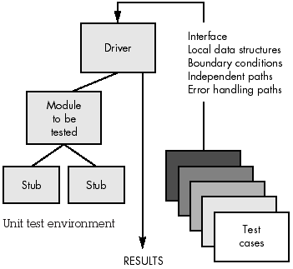

Slide 21
ii. INTEGRATION TESTING
"If they all units work individually under unit testing, do you doubt that they'll work when we put them together?"
The problem is “putting them together” - interfacing

Slide 22
ii. INTEGRATION TESTING
- Data can be lost across an interface
- One module can have an inadvertent, adverse affect on another;
- Subfunctions, when combined, may not produce the desired major function
- Global data structures can present problems.

Slide 23
Integration testing is a systematic technique for constructing the program structure while at the same time conducting tests to uncover errors associated with interfacing.

Slide 24
i. Top-down Integration
An incremental approach to construction of program structure.
Modules are integrated by moving downward through the control hierarchy, beginning with the main control module (main program).
Modules subordinate to the main control module are incorporated into the structure in either a depth-first or breadth-first manner.

Slide 25
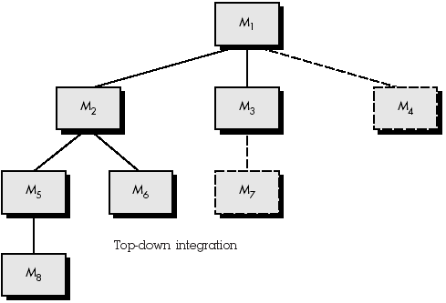
i. Top-down Integration
Depth-first integration integrates all components on a major control path of the structure
For example, selecting the left hand path, components M1, M2 , M5 would be integrated first. Next, M8 or (if necessary for proper functioning of M2) M6 would be integrated. Then, the central and right hand control paths are built.

Slide 26
Breadth-first integration
It incorporates all components directly subordinate at each level, moving across the structure horizontally.
From the figure, components M2, M3, and M4 would be integrated first. The next control level, M5, M6, and so on, follows.

Slide 27
5 Steps of Integration Process:
1. The main control module is used as a test driver and stubs are substituted for all components directly subordinate to the main control module.
2. Depending on the integration approach selected (i.e., depth or breadth first), subordinate stubs are replaced one at a time with actual components.
3. Tests are conducted as each component is integrated.
4. On completion of each set of tests, another stub is replaced with the real component.
5. Regression testing may be conducted to ensure that new errors have not been introduced.

Slide 28
The major disadvantage of the top-down approach is the need for stubs and the attendant testing difficulties that can be associated with them.

Slide 29
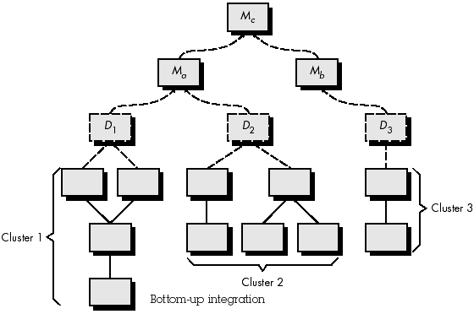
ii. Bottom-up Integration
Bottom-up integration testing, begins construction and testing with atomic modules
(i.e., components at the lowest levels in the program structure).
Processing required for components subordinate to a given level is always available and the need for stubs is eliminated.

Slide 30
4 Steps of a bottom-up integration strategy :
Low-level components are combined into clusters (builds) that perform a specific software sub function.
2. A driver (a control program for testing) is written
to coordinate test case input and output.
3. The cluster is tested.
4. Drivers are removed and clusters are combined moving upward in the program structure.

Slide 31
iii. Regression Testing
Each time a new module is added as part of integration testing, the software changes.
- New data flow paths are established
- New I/O may occur
- New control logic is invoked

Slide 32
iii. Regression Testing
These changes may cause problems with functions that previously worked flawlessly.
Regression testing is the re-execution of some subset of tests that have already been conducted to ensure that changes have not propagated unintended side effects.

Slide 33
iii. Regression Testing
Successful tests result in the discovery of errors, and errors must be corrected.
Whenever software is corrected, some aspect of the software configuration (the program, its documentation, or the data that support it) is changed.

Slide 34
iii. Regression Testing
The regression test suite (the subset of tests to be executed) contains three different classes of test cases:
• A representative sample of tests that will exercise all software functions.
• Additional tests that focus on software
functions that are likely to be affected by the
change.
• Tests that focus on the software components
that have been changed.

Slide 35
iv. Smoke Testing
Smoke testing is an integration testing approach used when “shrink wrapped” software products are being developed.
It is designed as a pacing mechanism for time-critical projects, allowing the software team to assess its project on a frequent basis.

Slide 36
iv. Smoke Testing
The smoke testing approach encompasses the following activities:
1. Software components that have been translated into code are integrated into a “build”
A build includes all data files, libraries, reusable modules, and engineered components that are required to implement one or more product functions.

Slide 37
iv. Smoke Testing
2. A series of tests is designed to expose errors that will keep the build from properly performing its function.
The intent should be to uncover “show stopper” errors that have the highest likelihood of throwing the software project behind schedule.
3. The build is integrated with other builds and the entire product (in its current form) is smoke tested daily.

Slide 38
iii. VALIDATION TESTING
At integration testing, software is completely assembled as a package, interfacing errors have been uncovered and corrected, and a final series of software tests—validation testing begins.
Validation succeeds when software functions in a manner that is expected by the customer.

Slide 39
iv. VALIDATION TESTING
Expectations are defined in the SRS
Information in Validation Criteria forms the basis for a validation testing approach.

Slide 40
i. Validation Test Criteria
Software validation is achieved through a series of black-box tests that demonstrate conformity with requirements.
After each validation test case has been conducted, one of two possible conditions exist:
(1) The function or performance characteristics conform to specification and are accepted
(2) A deviation from specification is uncovered and a deficiency list is created

Slide 41
ii. Configuration Review
An important element of the validation process is a configuration review.
The intent of the review is to ensure that all elements of the software configuration have been
properly developed, are cataloged, and have the necessary detail to strengthen the support phase of the software life cycle.
The configuration review is called an audit

Slide 42
iii. Alpha and Beta Testing
When custom software is built for one customer, a series of acceptance tests are conducted to enable the customer to validate all requirements.

Slide 43
iii. Alpha and Beta Testing
The alpha test is conducted at the developer's site by a customer.
The software is used in a natural setting with the developer "looking over the shoulder" of the user and recording errors and usage problems.
Alpha tests are conducted in a controlled environment.

Slide 44
iii. Alpha and Beta Testing
Beta test is conducted at one or more customer sites by the end-user of the software.
Unlike alpha testing, the developer is generally not present.
The Beta test is a "live" application of the software in an environment that cannot be controlled by the developer.
The customer records all problems (real or imagined) that are encountered during beta testing and reports these to the developer at regular intervals.

Slide 45
v. SYSTEM TESTING
Software is only one element of a larger computer-based system.
Software is incorporated with other system elements (e.g., hardware, people, information), and a series of system integration and validation tests are conducted.

Slide 46
v. SYSTEM TESTING
These tests fall outside the scope of the software process and are not conducted solely by software engineers.
A classic system testing problem is "finger-pointing", occurs when an error is uncovered, and each system element developer blames the other for the problem.

Slide 47
v. SYSTEM TESTING
Instead, the software engineer should anticipate potential interfacing problems and
i. Design error-handling paths that test all information coming from elements of the system,
ii. Conduct a series of tests that simulate bad data or other potential errors

Slide 48
v. SYSTEM TESTING
iii.Record the results of tests to use as "evidence" if finger-pointing does occur
iv.Participate in planning/design of system tests
System testing is actually a series of different tests whose primary purpose is to fully exercise the computer-based system.

Slide 49
Types of System tests:
i. Recovery Testing

Slide 50
i. Recovery Testing
Many computer based systems must recover from faults and resume processing within a prespecified time.
In some cases, a system must be fault tolerant; that is, processing faults must not cause overall system function to cease.
In other cases, a system failure must be corrected within a specified period of time or severe economic damage will occur.

Slide 51
i. Recovery Testing
Recovery testing is a system test that forces the software to fail in a variety of ways and verifies that recovery is properly performed.
If recovery is automatic (performed by the system itself), reinitialization, checkpointing mechanisms, data recovery, and restart are evaluated for correctness.
If recovery requires human intervention, the mean-time-to-repair (MTTR) is evaluated to determine whether it is within acceptable limits.

Slide 52
ii. Security Testing
Any system that manages sensitive information is a target for illegal penetration.
Penetration spans a broad range of activities:
hackers who attempt to penetrate systems for sport;
disgruntled employees who attempt to penetrate for revenge;
dishonest individuals who attempt to penetrate for illicit personal gain.

Slide 53
ii. Security Testing
Security testing attempts to verify that protection
mechanisms built into a system will protect it from improper penetration.
During security testing, the tester plays the role(s) of the individual who desires to penetrate the system.
Anything goes!

Slide 54
ii. Security Testing
The tester may attempt to acquire passwords through external clerical means; may attack the system with custom software designed to breakdown any defenses that have been constructed; may overwhelm the system, thereby denying service to others; may purposely cause system errors, hoping to penetrate during recovery; may browse through insecure data, hoping to find the key to system entry.
Given enough time and resources, good security testing will ultimately penetrate a system.
The role of the system designer is to make penetration cost more than the value of the information that will be obtained.

Slide 55
iii. Stress Testing
Stress tests are designed to confront programs with abnormal situations.
"How high can we crank this up before it fails?"
Stress testing executes a system in a manner that demands resources in abnormal quantity, frequency, or volume.

Slide 56
iii. Stress Testing
special tests may be designed that generate ten interrupts per second, when one or two is the average rate,
(2) input data rates may be increased by an order of magnitude to determine how input functions will respond

Slide 57
iii. Stress Testing
(3) test cases that require maximum memory or other resources are executed
(4) test cases that may cause thrashing in a virtual operating system are designed
(5) test cases that may cause excessive hunting for disk-resident data are created.

Slide 58
iv. Performance Testing
For Real-time and embedded systems, software that provides required function but does not conform to performance requirements is unacceptable.
Performance testing is designed to test the run-time performance of software within the context of an integrated system.
Performance testing occurs throughout all steps in the testing process.

Slide 59
iv. Performance Testing
Even at the unit level, the performance of an individual module may be assessed as white-box tests are conducted.
Performance tests are often coupled with stress testing and usually require both hardware and software instrumentation.
External instrumentation can monitor execution intervals, log events (e.g., interrupts) as they occur, and sample machine states on a regular basis.

Slide 60
THE ART OF DEBUGGING
Debugging occurs as a consequence of successful testing.
When a test case uncovers an error, debugging results in the removal of the error.

Slide 61
i. The Debugging Process
Debugging is not testing but always occurs as a consequence of testing.
The debugging process begins with the execution of a test case.
Results are assessed and a lack of correspondence between expected and actual performance is encountered.

Slide 62
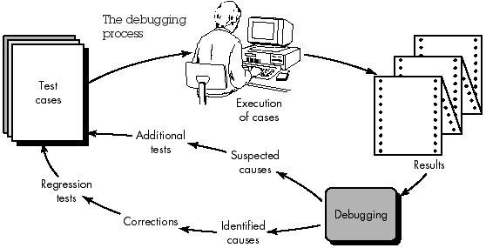
i. The Debugging Process

Slide 63
i. The Debugging Process
In many cases, the non corresponding data are a symptom of an underlying cause as yet hidden.
The debugging process attempts to match symptom with cause, leading to error correction.
The debugging process will either find the cause and correct it, or the cause will not be found.

Slide 64
i. The Debugging Process
If the cause if not found, the person performing debugging may suspect a cause, design a test case to help validate that suspicion, and work toward error correction in an iterative fashion

Slide 65
i. The Debugging Process
During debugging, errors encountered range from mildly annoying (e.g., an incorrect output format) to catastrophic (e.g. system fails, causing serious economic or physical damage).
As the consequences of error increase, the amount of pressure to find the cause also increases.
Often, pressure sometimes forces a software developer to fix one error and at the same time introduce two more.

Slide 66
iii. Debugging Approaches
Debugging has one main objective:
To find and correct the cause of a software error.
The objective is realized by a combination of systematic evaluation, intuition and luck.

Slide 67
iii. Debugging Approaches
A simple non-software example: A lamp in my house does not work. If nothing in the house works, the cause must be in the main circuit breaker or outside; I look around to see whether the neighborhood is blacked out. I plug the suspect lamp into a working socket and a working appliance into the suspect circuit. So goes the alternation of hypothesis and test.

Slide 68
Three categories for debugging approaches
i. Brute Force
ii. Back Tracking
iii. Cause Elimination

Slide 69
i. Brute Force
The brute force category of debugging is probably the most common and least efficient method for isolating the cause of a software error.
We hope that somewhere in the mess of information that is produced we will find a clue that can lead us to the cause of an error.
It more frequently leads to wasted effort and time.

Slide 70
ii. Backtracking
Backtracking is a fairly common debugging approach that can be used successfully in small programs.
Beginning at the site where a symptom has been uncovered, the source code is traced backward (manually) until the site of the cause is found.
As the number of source lines increases, the number of potential backward paths may become unmanageably large.

Slide 71
iii. Cause Elimination.
It is manifested by induction or deduction and introduces the concept of binary partitioning.
Data related to the error occurrence are organized to isolate potential causes.
A "cause hypothesis" is devised and the data are used to prove or disprove the hypothesis.
Alternatively, a list of all possible causes is developed, tests are conducted to eliminate each.

